Slide 1
Data
Communication and
Networking Lab
Snapdragon
T.Dharani (1818113)
K.Sowndarya(1818153)

Slide 2
Implemention of ARP Protocol
Aim:
To write a python program to simulate
Address Resolution Protocol (ARP).

Slide 3
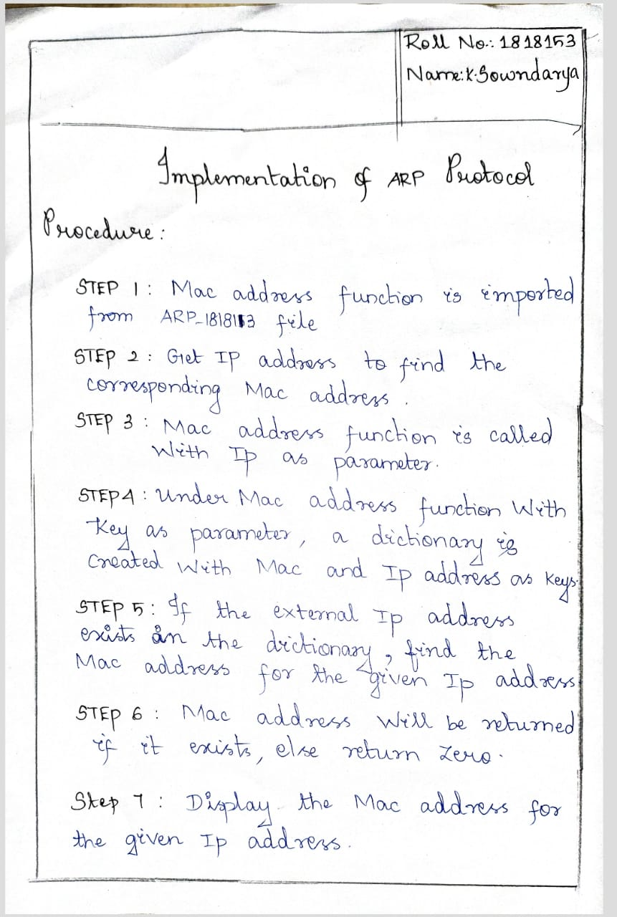

Slide 4
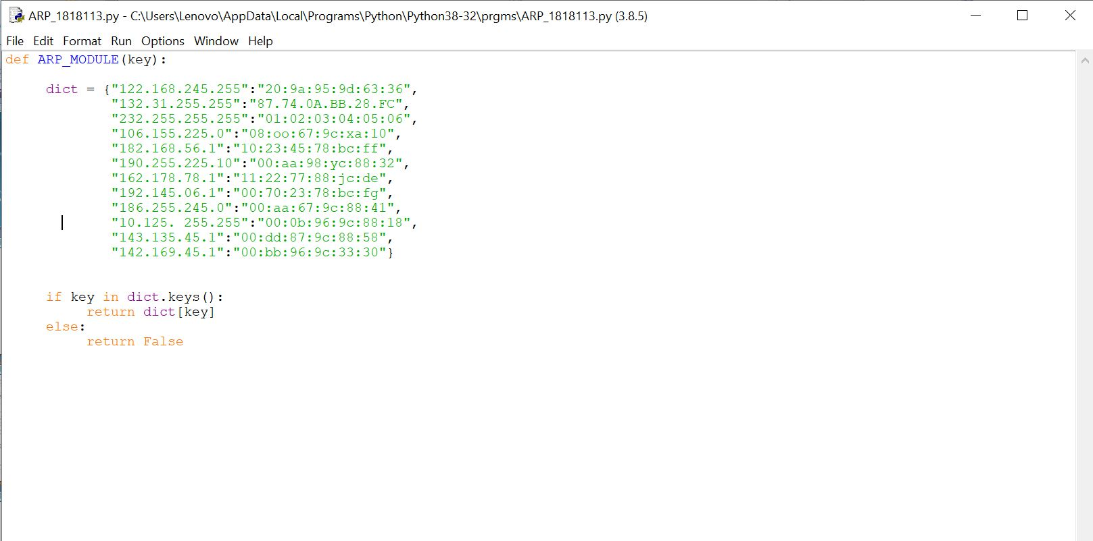

Slide 5
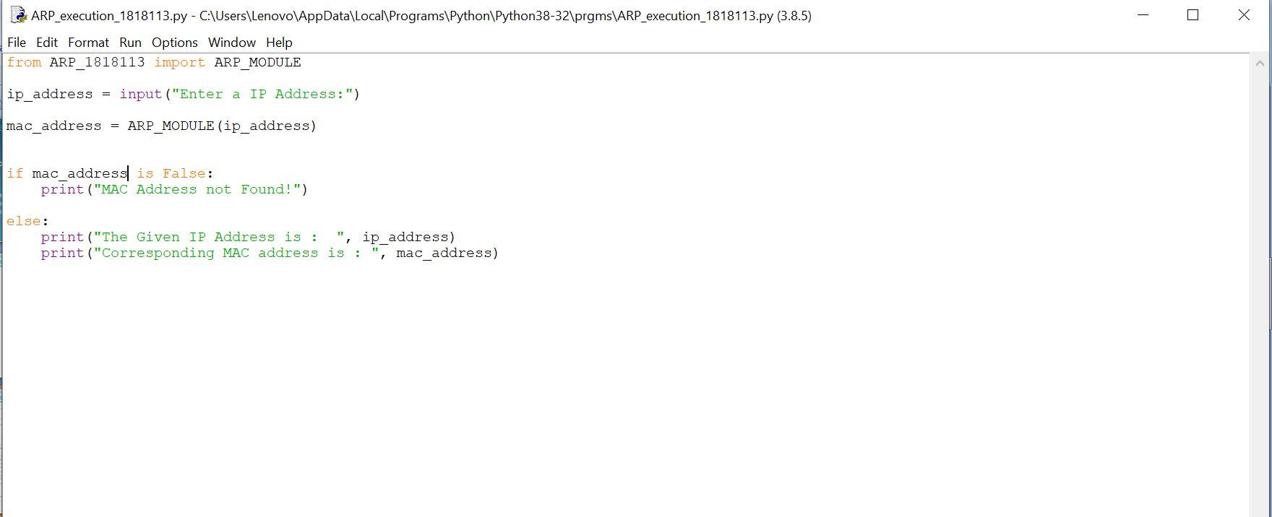

Slide 6
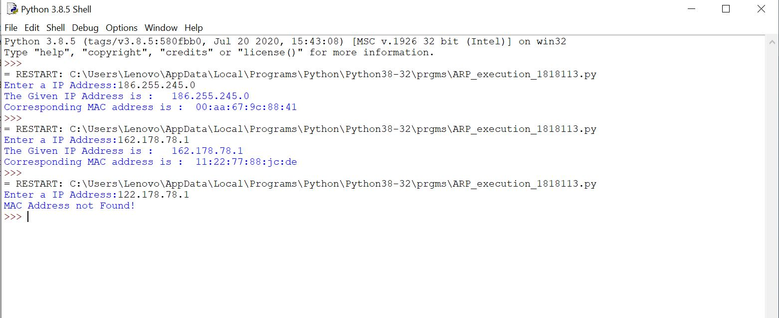

Slide 7
RESULT:
Thus, the python program to simulate Address Resolution Protocol(ARP)
was executed successfully.

